Slide 1
Project 1
Umar F.

Slide 2
Nodes (TSV File)
Contains basic information about each entity
id | name | kind
Disease::DOID:0050156 | Idiopathic Pulmonary Fibrosis | Disease
Compound::DB09028 | Cytisine | Compound
Gene::9997 | SC02 | Gene

Slide 3
Edges (TSV File)
Defines relationships between these entities
source | metaedge | target
Disease::DOID:0050156 | TREATS | Compound::DB09028
Disease::DOID:0050156 | CAUSES | Gene::9997
Disease::DOID:0050156 | OCCURS_IN | Anatomy::UBERON:0000002

Slide 4

Docker
Docker is required because that is how I installed MongoDB and Neo4j
Docker is a set of platform as a service (PaaS) products that use OS-level virtualization to deliver applications through containers

Slide 5
MongoDB (Document Store)
Stores the metadata for each node
Usually used for storing JSON-like documents with flexible schemas
Beneficial in my use case because we have data that has variable attributes

Slide 6
Neo4j (Graph Database)
Stores nodes and edges to capture complex relationships among data objects
Neo4j is optimized for traversing relationships and executing complex queries over heterogeneous networks
Natural fit for a complex model like HetioNet

Slide 7

Queries

Slide 8
Queries
To run query 1:
To run query 2:
python main.py query1 --diseaseId Disease::DOID:0050156 --neo4jUri bolt://localhost:7687
python main.py query2 --diseaseId Disease::DOID:0050156 --neo4jUri bolt://localhost:7687

Slide 9
Node Data
Edge Data
Data Ingestion
Insert Nodes
MongoDB
(Document Store)
Insert Edges
Neo4j (Graph Database)
Nodes & Relationships
Query Engine

Slide 10

Streamlit GUI Example

Slide 11
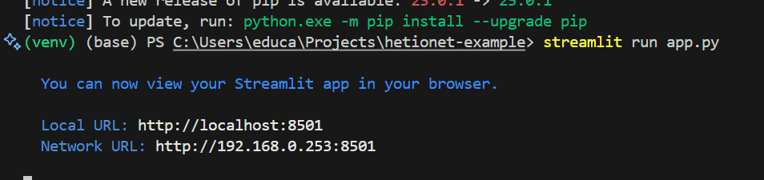

Slide 12
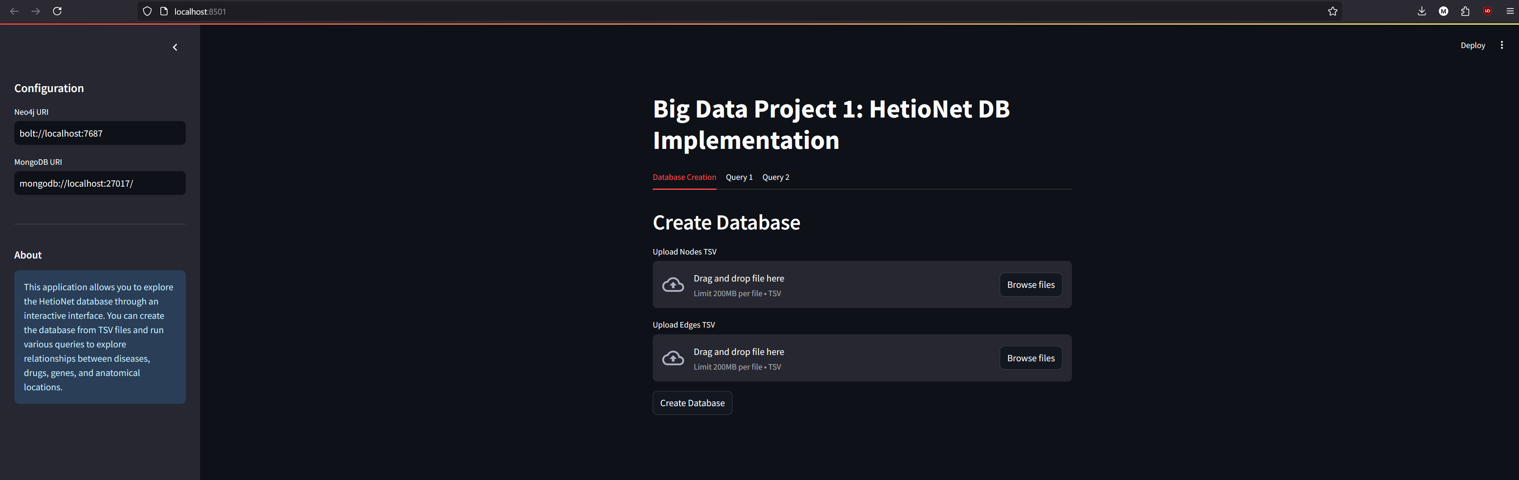

Slide 13
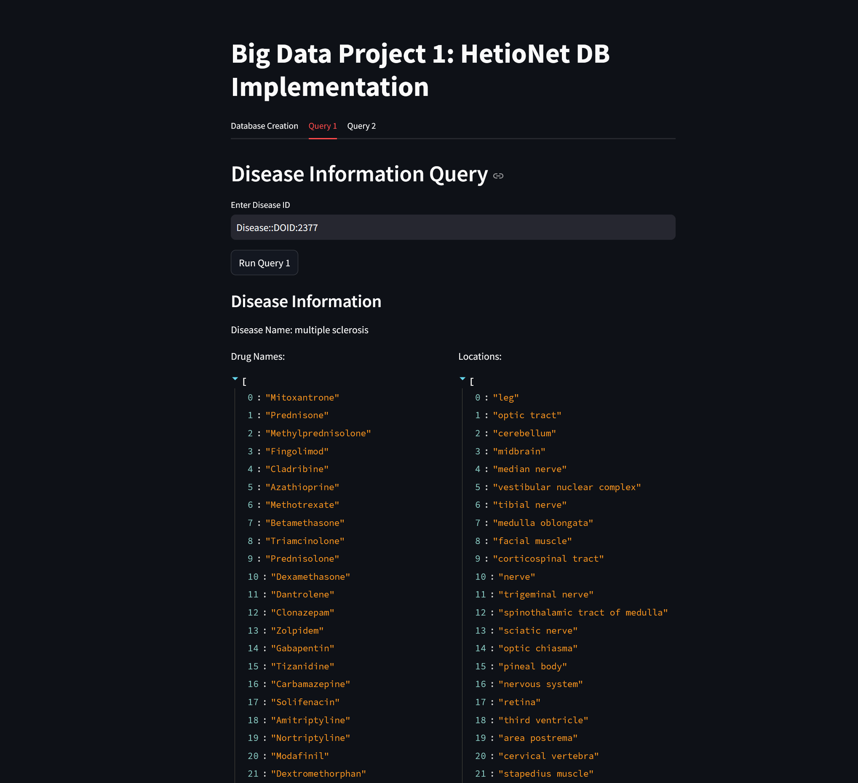

Slide 14
